Slide 1
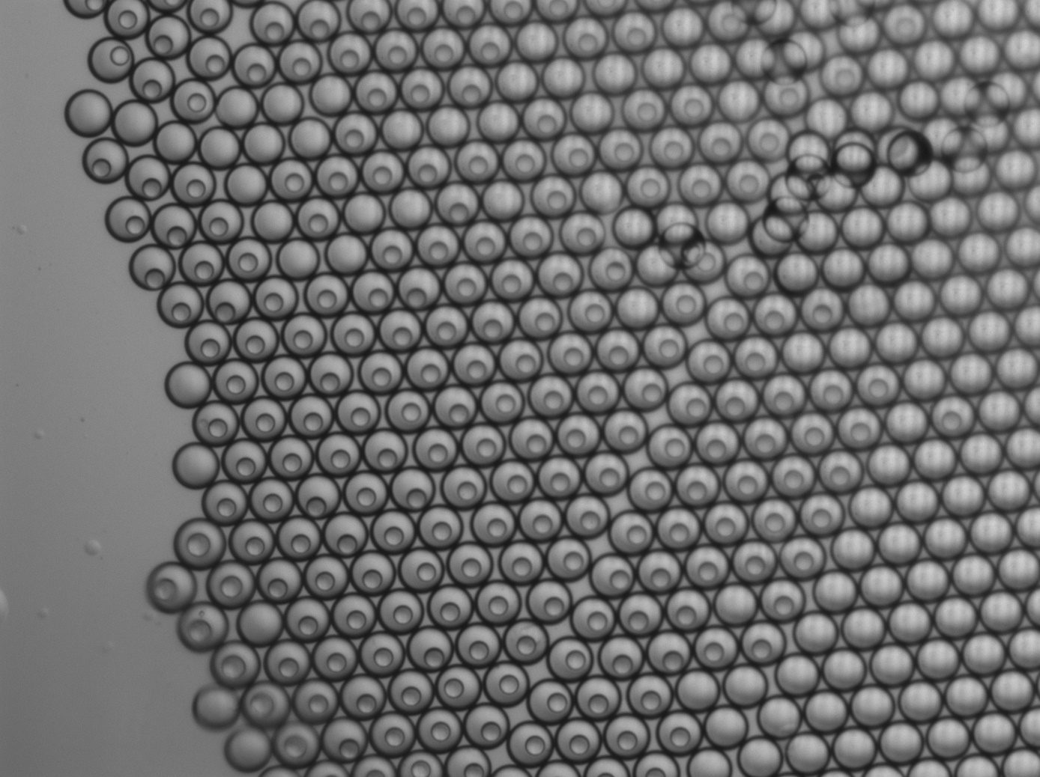
Notes:
New chip1

Slide 2
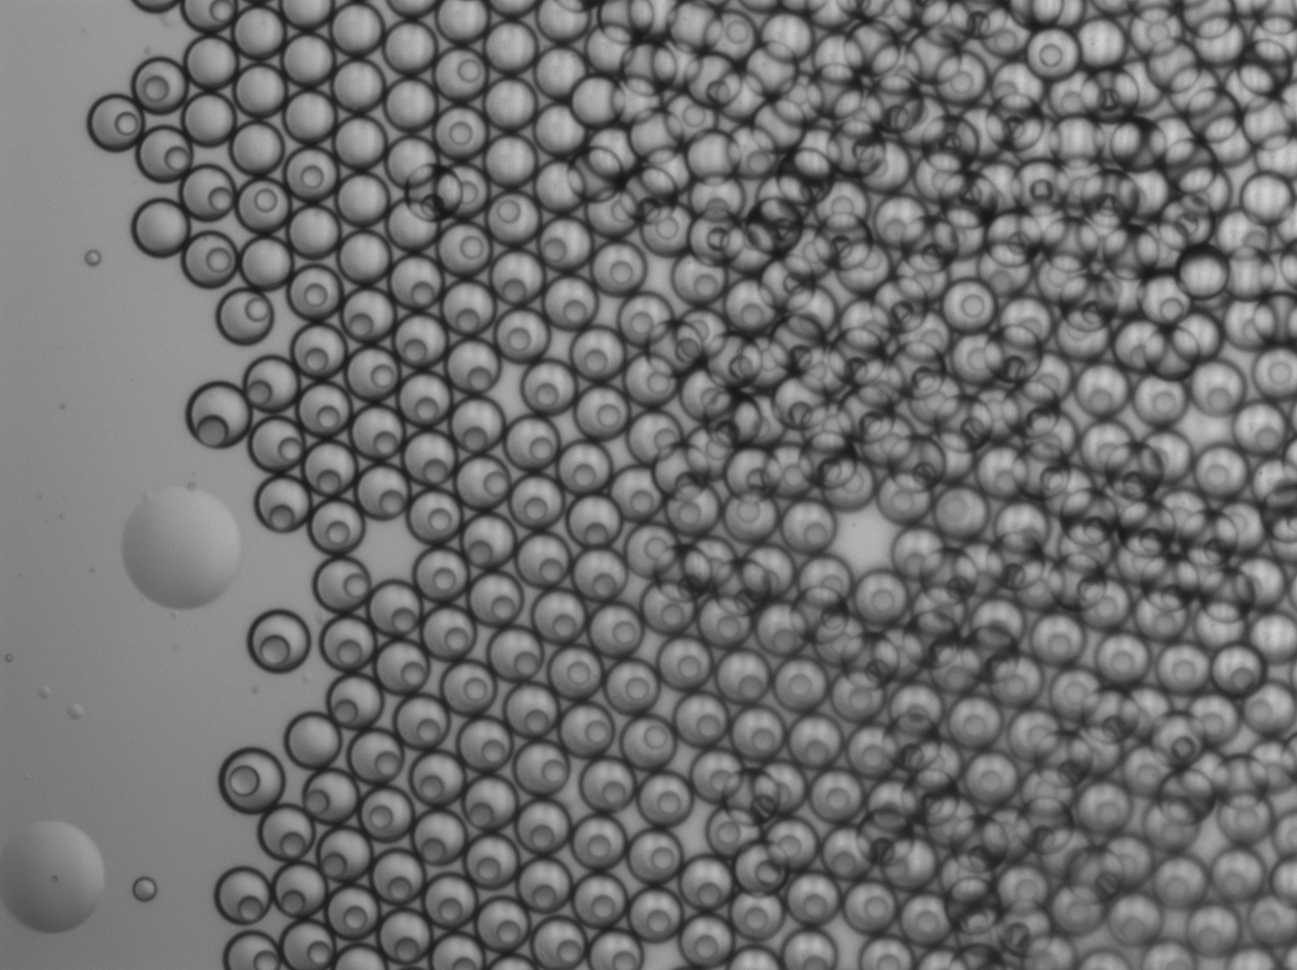
Notes:
chip2

Slide 3
Notes:
New chip3

Slide 4
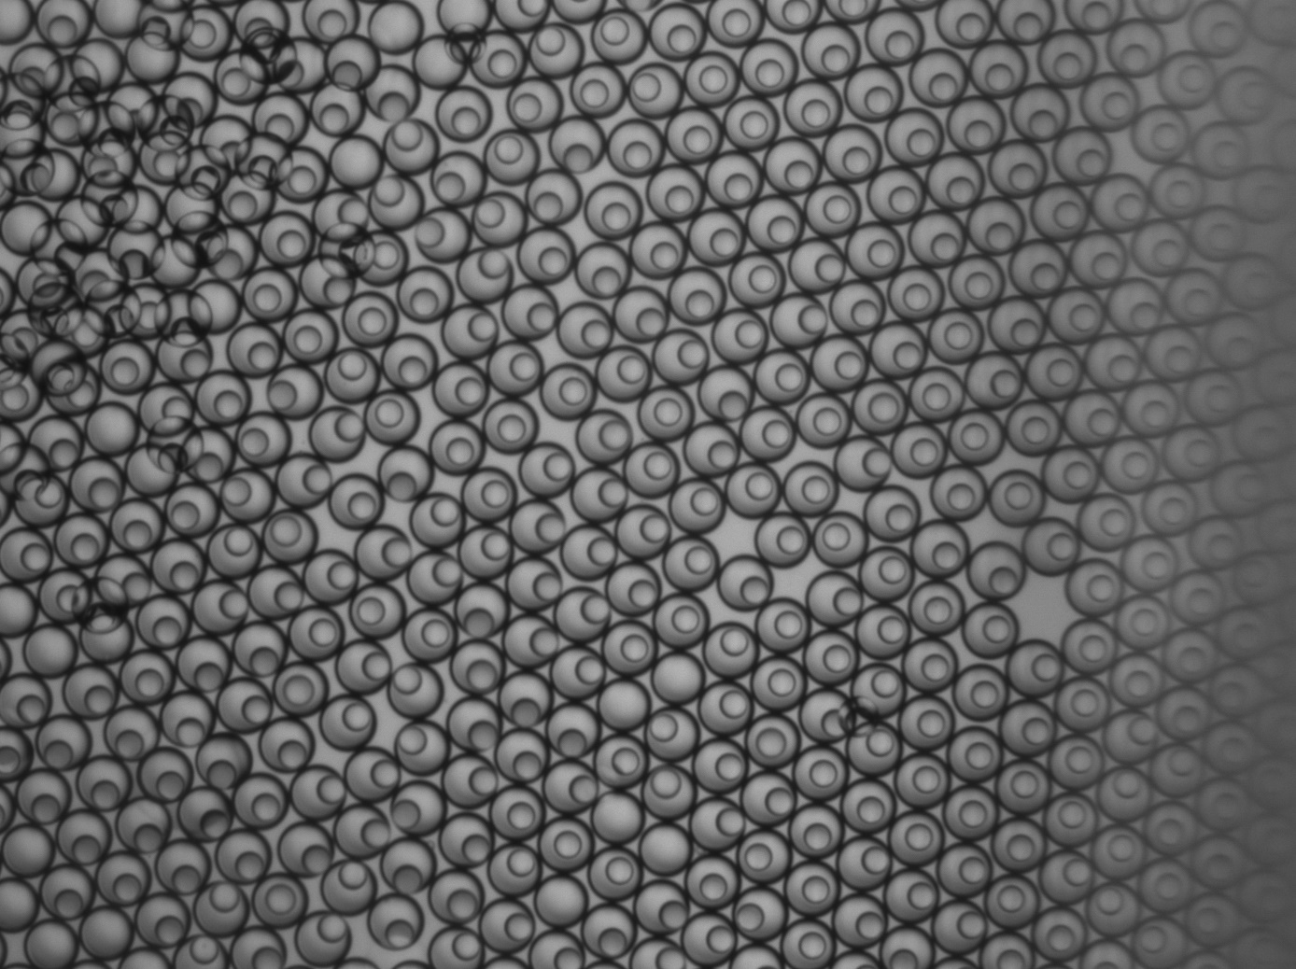
Notes:
New chip4

Slide 5
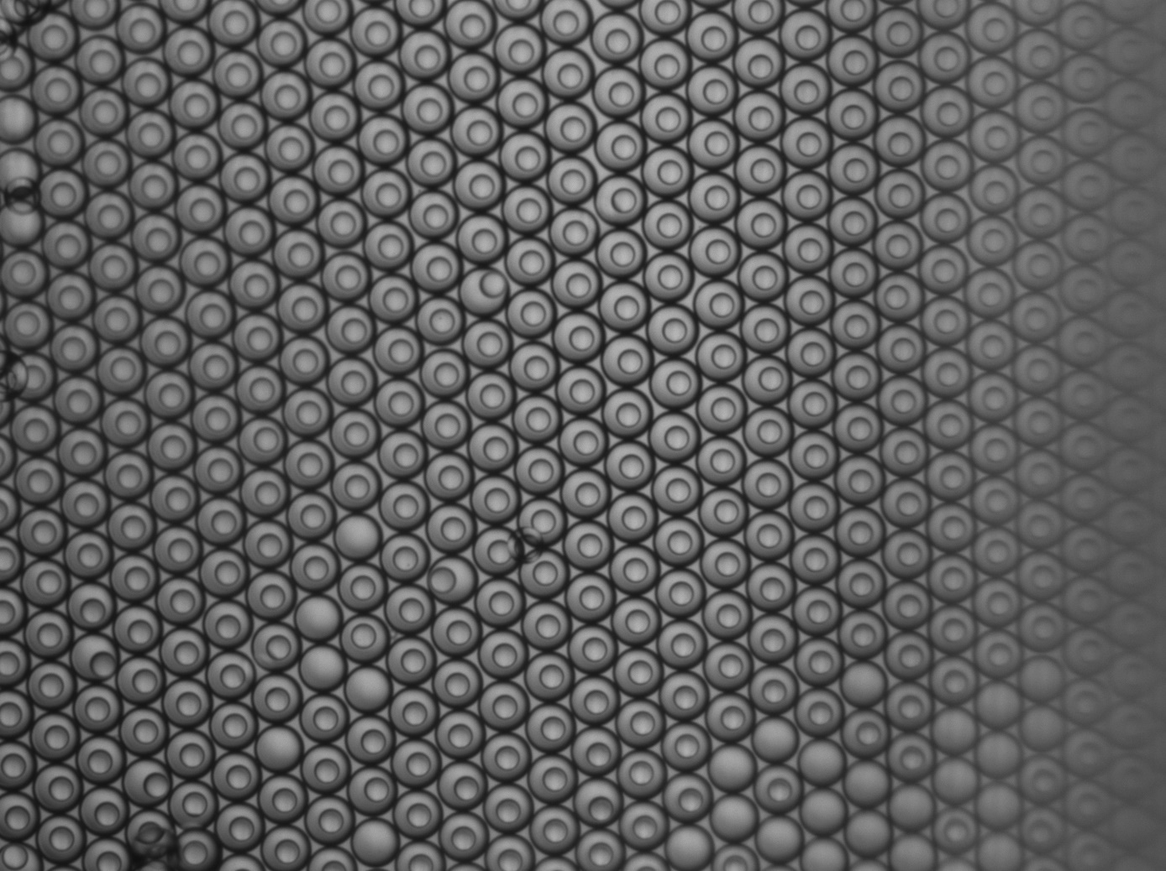
Notes:
New chip5

Slide 6
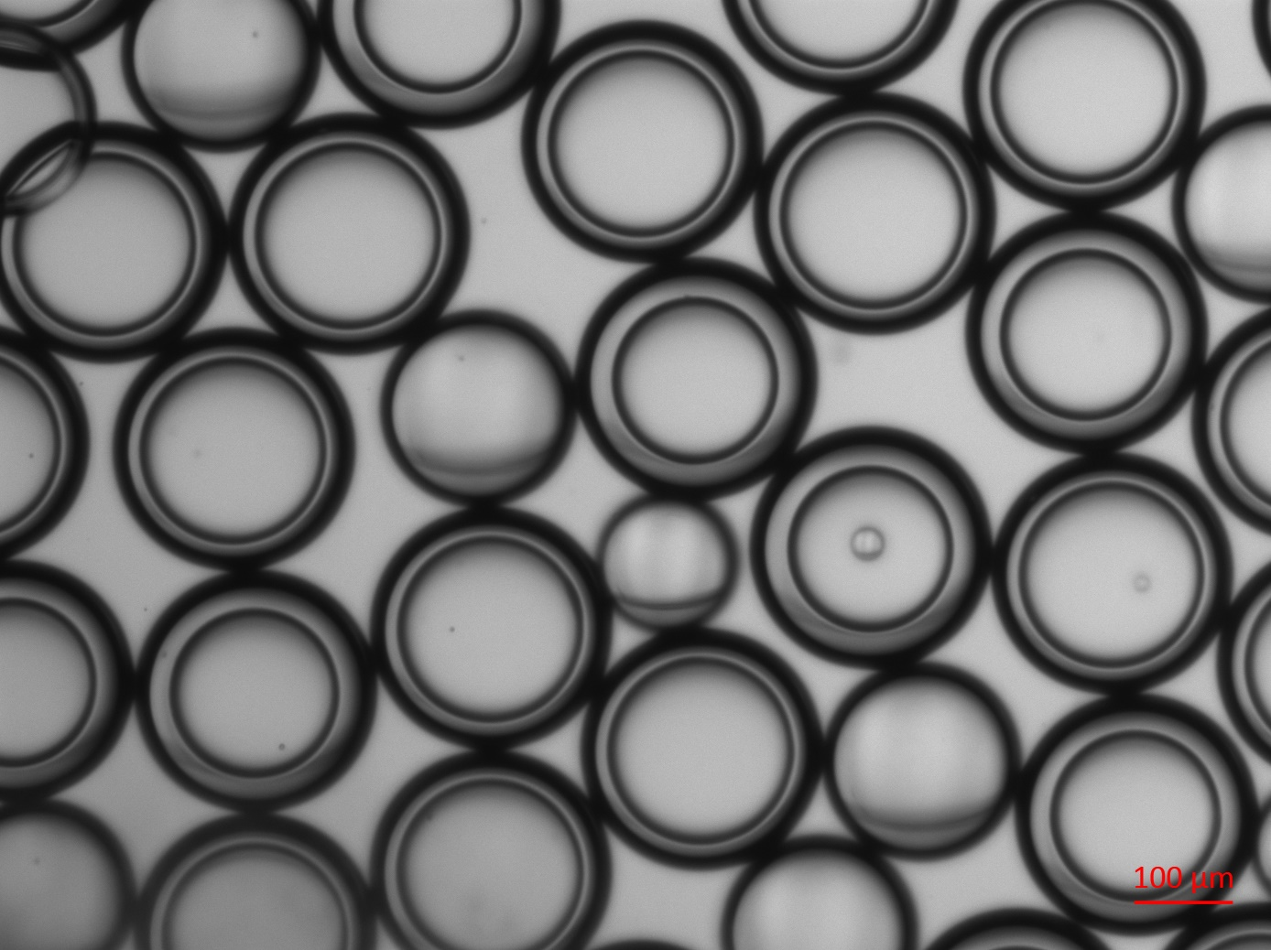
Notes:
Old chip1

Slide 7
Notes:
Old chip2

Slide 8
Notes:
Old chip3

Slide 9
Notes:
Old chip4

Slide 10
Notes:
Old chip5

